Slide 1
FILMS ART STYLE VS MOVIES NOW BEING MADE
Presented by
Shoaib zafar and Abdul Basit

Slide 2
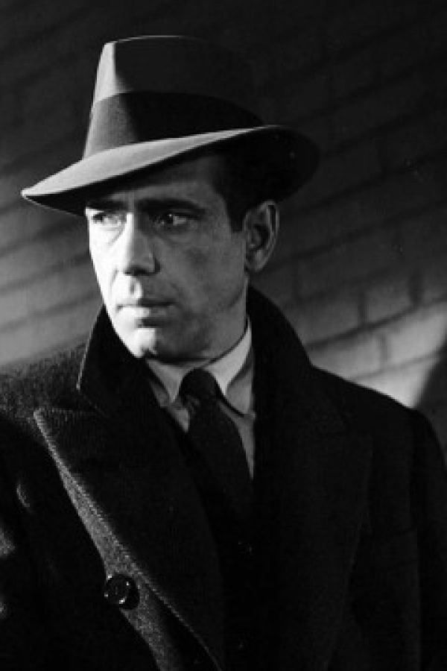
FILM art style & NOIR
The film noir is an art style and an aesthetic to tell character driven stories. The idea of the word Noir comes with philosophy of film in the dark. The film in the dark is an art style which was followed by the filmmakers in early 90s to build dark and gothic narratives. In film noir the style of the storytelling is more focused on visuals which allows the character to take more technical decision in the films world . In noir we never the happy ending but we do get the full conclusion of every character arc. In noir the films world is itself a character it shows the darker face of the society that’s it is called
“DARK FILM”

Slide 3
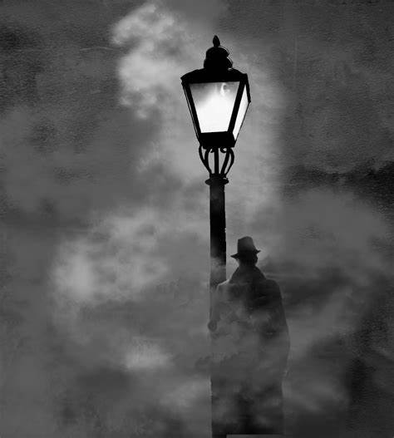
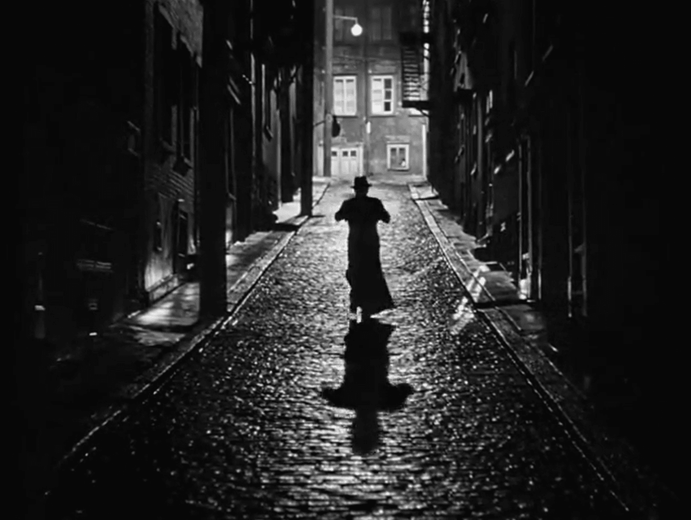
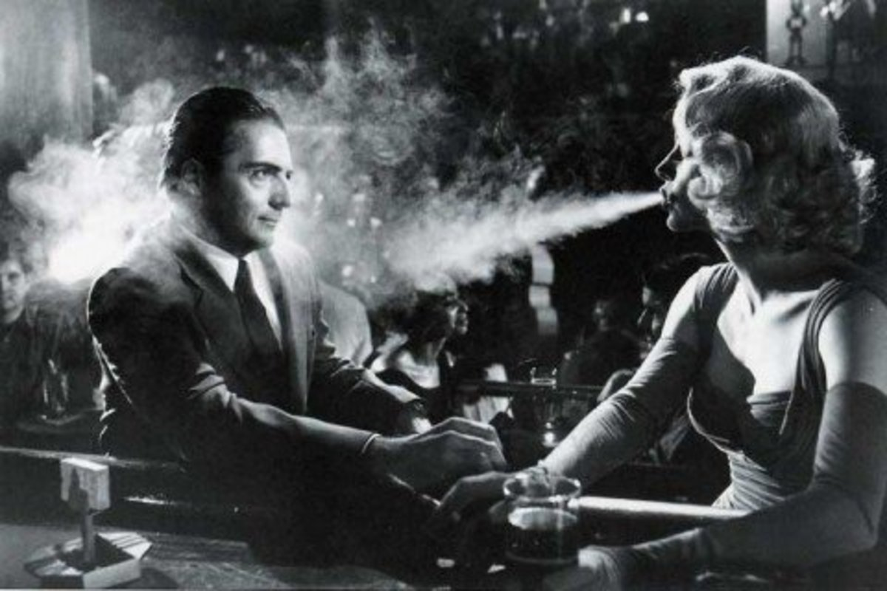
THE VISUAL PHILOSOPHY OF NOIR
A DAGGER IN BROAD DAY LIGHT
RUNNING TOWARDS THE LIGHT
EVERY THING IS FAIR IN LOVE
“In noir a murderer or a serial killer never dies because it is the society who made them . In film noir the idea of evil and darkness is unstoppable force”
“this is a classic style of concluding story in film noir where the character disappears into the light when the film ends. There is always a mystery’’
“The style of expressing deep affection in film noir is bold and wild. noir shows female characters as a mysterious figure more like a law in itself that can use men”

Slide 4
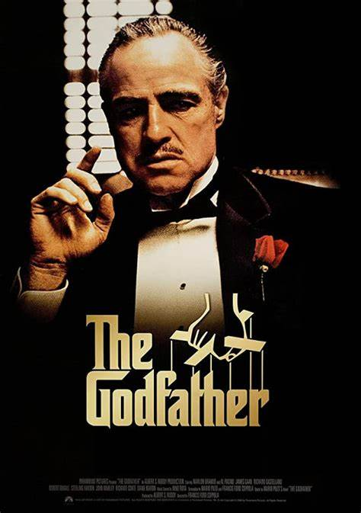
God FATHER film noir
“An outstanding piece of film noir . This film carries a journey of Corleone family with a character of Vito Corleone and the story of his children trying to step into their father shoes. "A man who builds business, power and spends time with his family is a real men a "God Father". The first act I and second act ii deals with the action of his children trying to build power and their consequences. The final act III establishes those first words of Vito Corleone and his position as a mantle that will be given to a real men amazing story deep narrative and amazing cinematography”

Slide 5
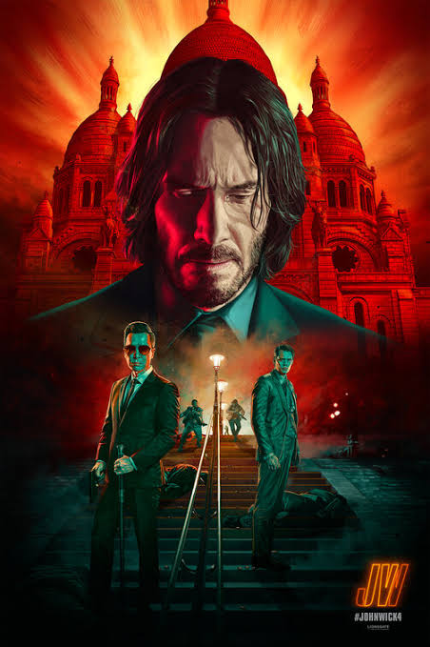
Jhon wick chapter 4 neo noir
“ A beautiful journey of light and dark life and death but some times it is hard to die”. The plot of film is focused on how john wick would takedown high-table so he could redeem himself as a person who lived a good life. The story and the narrative with neon lightning and noir film aesthetics is presenting the world of assassination . The final act of this film is mind-blowing overhaul of gun fu. The director took inspiration from noir films and tells the idea of life and death in a more technical way
“A Good death only comes after a good life”

Slide 6
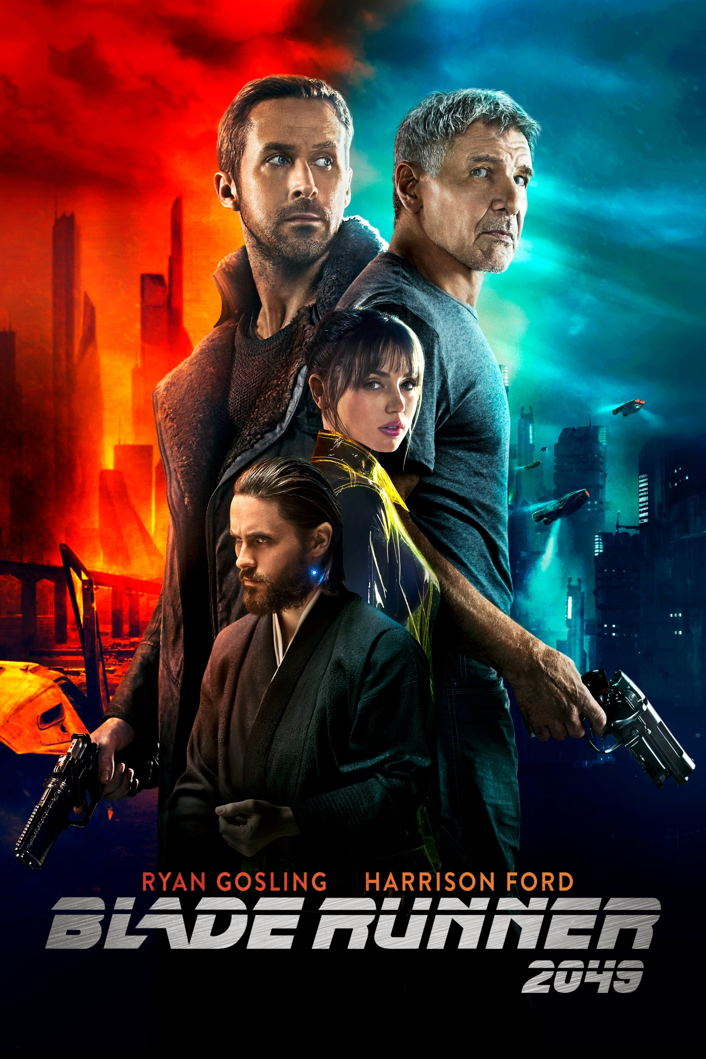
BLADE RUNNER 2049 Neo noir
. The character of Ryan gosling constant k was hired by the evil organization named Wallace corporation. The character of constant k which is basically a nexus 9 replicant is on a mission to kill all previous replicants nexus 8. In this journey of identity crisis the world has completely consumed closer to its extinction. The character of constant k with his AI holographic girl friend JOI founds that he was basically born through natural birth he is special among all replicants then he founds the reason of those memories of child hood were running through his head. This film explains that it is purpose which creates our life path it makes us able to love each other even as a stranger “
“Sometimes to love some one you got to be
Stranger”

Slide 7
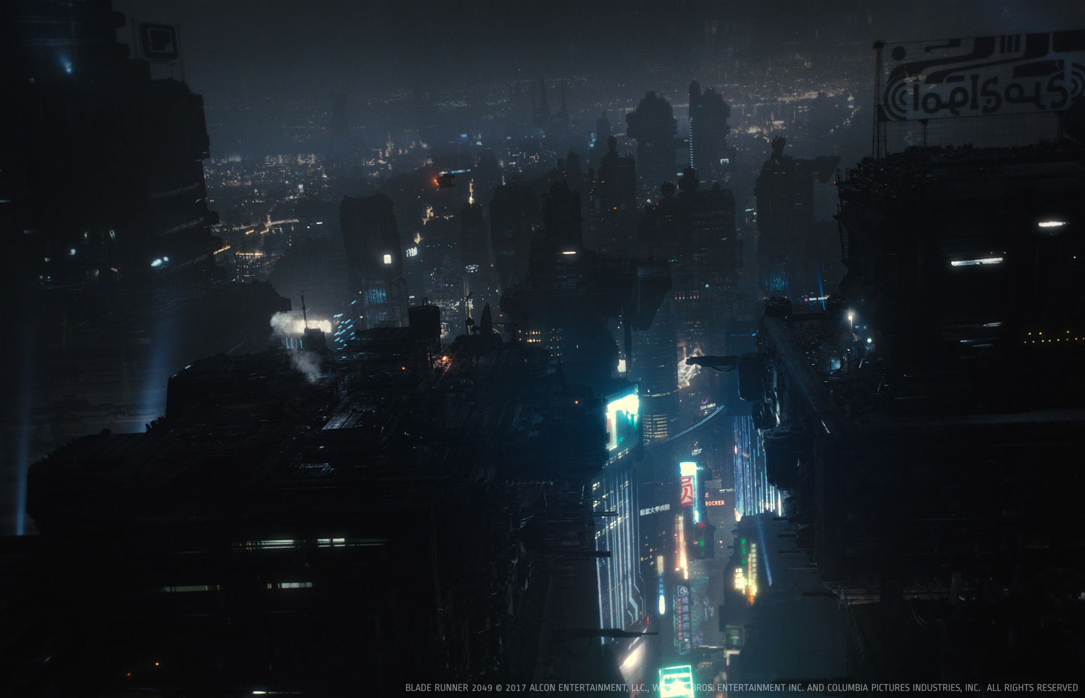
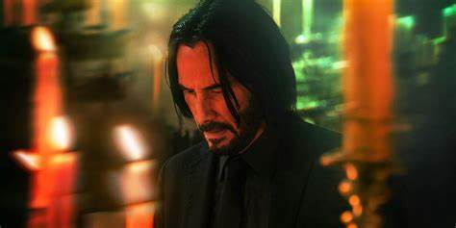
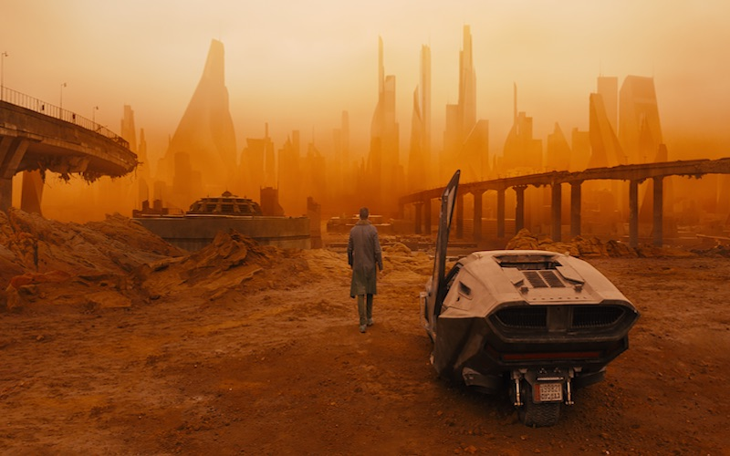
Visual style of neo noir
LIGHT & DARK
LIFE & DEATH
IN THE SEARCH OF OUR BEGINNING WE CAME TO OUR END
A NOIR WITH NEON LIGHTS
“A dark film with neo lighting cinematic experience with classic noir at its core is called Neo noir”
“In this frame the character of john wick was saying hello to his death because he doesn’t know whether he is going to die”
“In this frame we are watching a post apocalyptic world down to its last decade survival we see flying cars and everything is just shattered like sand in the desert”

